Slide 1
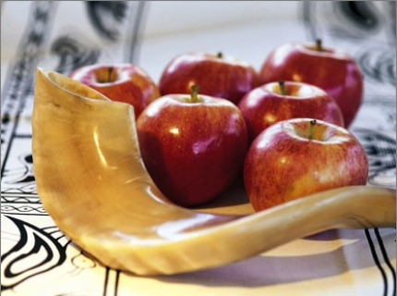
Shanah Tova – Happy New Year!
Your Guide to High Holy Days at CMI
We are excited to welcome our community home to celebrate High Holy Days 5783!
On Rosh Hashanah we will hear the shofar sound 100 times, each note part of the tekiah,
awakening, shivarim, weeping, or teruah, call to action. These sounds resonate deep within
us as we lift our eyes, weep for our fractured world and act to repair it. Of each, the blast we remember most is t’kiah g’dolah, the long note that gives us strength, courage and comfort. This long note, the final sound of Yom Kippur, echoes within us until the next Rosh Hashanah. As we enter the final month of our year and the sound finally starts to fade, we begin to rouse ourselves again.
In anticipation of our Days of Awe, during the final month of Elul, we will begin our Shabbat
services with the shofar. This tradition reminds us to prepare ourselves for the holy days
ahead. We call this process chesbon hanefesh, an accounting of the soul. We take note of the
good deeds and the not so good deeds from our past year and look at our balance sheet. We
do our best to make amends to people we have hurt and we resolve to enter the year with
more chesed, lovingkindness, than the year before. A process called teshuvah, returning to be
the best people we can be and hakarat hatov, recognizing the good that we have done.
Don’t forget about the good! Each of us has fulfilled the commandment to love our neighbor
or stranger, and each of us should take time to feel good about the light that we bring to our
community.
No matter how you connect with us these High Holy Days, we are grateful for your light, love,
and participation in the CMI family.
L’shanah Tova u’metukah,
Wishing you a happy, sweet, and healthy new year,
Congregation Mishkan Israel

Slide 2
High Holy Day Schedule
Selichot Community Program and Service
Saturday, September 9, 7:00 pm at B’nei Israel in Southbury
Memorial Service
Sunday, September 10, 1:00 pm
Our service is held at the CMI Cemetery, 701 Whalley Ave., New Haven
Rosh Hashanah
Friday, September 15
8:00 pm Traditional Service
Saturday, September 16
9:15 am Young Family Service
10:00 am Morning Service
10:30 am Youth Program/Service
2:00 pm Family Service
Sunday, September 17
10:30 am 2nd Day Rosh Hashanah Congregational Service
10:30 am 2nd Day Rosh Hashanah
Youth Service/Program
12:30 pm Tashlich at the Bridge behind Eli Whitney Museum, 915 Whitney Ave., Hamden
Yom Kippur
Sunday, September 24
8:00 pm Kol Nidre Service
Monday, September 25
9:15 am Young Family Service
10:00 am Morning Service
10:30 am Youth Program/Service
12:30 pm Reflection Service
2:00 pm Adult Study with Prof. Shelly Kagan
2:00 pm Family Service
3:00 pm Adult Study with Confronting Racism
3:30 pm Afternoon Service
5:15 pm Yizkor (Memorial)
6:00 pm Ne’ilah/Havdalah
Sukkot
Saturday, September 30
10:30 am Sukkot Service
Simchat Torah
Friday, October 6
6:00 pm Simchat Torah Service
Saturday, October 7
10:30 am Simchat Torah with Yizkor Services

Slide 3
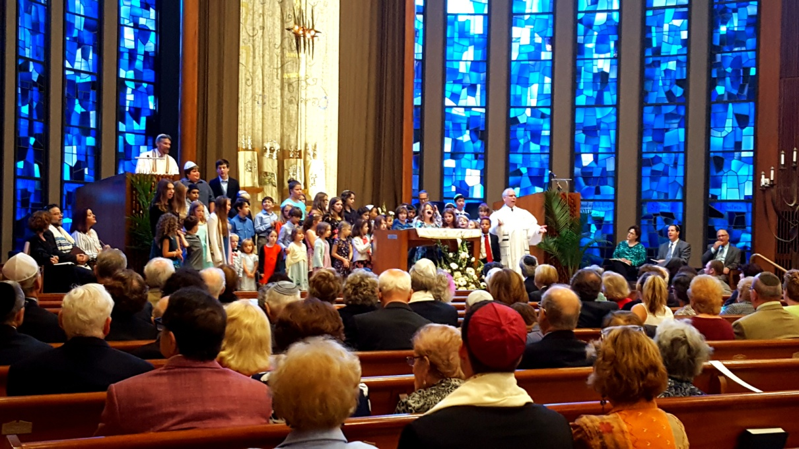
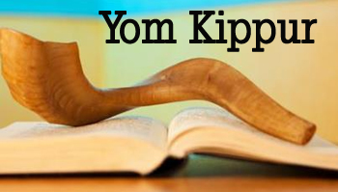
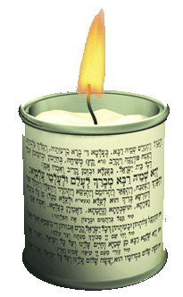
What to Expect
Traditional Services Congregation Mishkan Israel’s traditional High
Holy Day service. Experience the power and spiritualty of the holidays with our clergy,
beautiful organ, and choir.
Family Services ￼ A worship opportunity for the entire family on
the day of each holiday with the clergy and a
special story. No ticket required – bring friends!
Youth Services ￼ Begin as a family with the congregation at 10:00
in the sanctuary. Following a special blessing and prayer by our youth, children in Kindergarten – 6th grade will leave for a special service/program with Michelle. Everyone will rejoin at 12:30 for kiddush.
Young Family Services Parents are invited to bring their families to this tot-friendly service, which is geared to children birth to five years of age.
Memorial Service
Each year we gather at the CMI cemetery to remember our loved ones whose memory we
hold close during these sacred days.
Selichot Prepare for the High Holy Day Season of personal reflection on the Saturday night before Rosh Hashanah.
Second Day Rosh Hashanah Tashlich Join us at CMI for worship followed by tashlich, casting of our transgressions, at the bridge next to the Eli Whitney Museum. Please bring your own seed.
Shabbat Shuvah The Shabbat between Rosh Hashanah and Yom Kippur is called the “Shabbat of returning”. This service motivates us to “return” to being the very best versions of ourselves.
Kol Nidre￼ The name of the prayer which begins Yom Kippur and the name by which we often refer to the Yom Kippur evening service
Yom Kippur Study Sessions
Professor Shelly Kagan will lead a meaningful and interesting group text study. The Confronting Racism planning group will lead a reading and discussion of Reverend Martin Luther King Jr.’s “Letter from the Birmingham Jail.”
Yom Kippur Reflection Service
The reflection service provides an opportunity for us to reflect on the past, present, and future with the aid of original and thoughtfully selected writings and music by CMI members. Please
contact Stan Friedman at stanf24@hotmail.com to sign up.
Yizkor Service
During Yizkor we remember our loved ones who
are no longer with us. We will read the names of our congregants who have passed away since the last High Holy Days. If you wish the names of
others who have passed away since September 2021 to be read, please call the Temple office.
Yom Kippur Afternoon: Mincha, Yizkor, Neilah We hope that everyone will join us for Yom Kippur afternoon in worship filled with t’shuva, music, hope, the story of Jonah, followed by the yizkor service and concluding with neilah and Havdalah.
CMI Memorial Book
Each year our community creates a book remembering all who are with us in spirit during
the days of Awe. Visit cmihamden.org/hhd for the dedication form or call the CMI office.

Slide 4
How to Register, Access and Participate in HHD at CMI
Participate in Person:
Tickets will be sent mid-September via email to those who have either set up a recurring payment plan or fulfilled one-quarter of their annual membership commitment. You can purchase additional tickets for family members and make an additional donation to cover the added expense of our multi-access HHD services this year by going to cmihamden.org/hhd
Participate Online: Access Livestream Services
You can access livestream services for viewing only at cmihamden.org/livestream.
In order to maximize participation, the prayers will all be on the screen, like Shabbat services. We will be using our prayer book Mishkan HaNefesh and each slide will have the corresponding page number identical to the prayer books we are using in the sanctuary.
Tzedakah
As is our annual custom, we will be conducting a food drive these High Holy Days. By donating food, we hope to help those who's fast does not end at sundown. Bags will be handed out at Rosh Hashanah for you to fill and return on Yom Kippur. Please also consider donating to our Hunger Fund online at cmihamden.org or by sending on a check to CMI.
Yikzor names
In order to add your loved one’s names for remembrance during the Yizkor Service, please fill out the form online or call the CMI office. All memorial book names must be received by August 30th
For those needing extra assistance:
If you need transportation we can help! Submit a receipt to the office for your cab or uber fare for reimbursement. We will have designated handicap parking spaces and if you require special seating, please call the office at 203-288-3877 to request a reserved spot.

